Slide 1
Medical Monitor Proposal
Jheddy Melendez
Matthew Szekely

Slide 2
What does it do?
First, the device collects statistics about the patient
Then, after a bit of analyzing, it sends it to the patient’s phone wirelessly
From there, the patient’s doctor can look at the data and do whatever they think may be necessary
The device can also detect certain theoretical dangers to the patient’s health.
In such cases, instead of sending the data to the phone, it will immediately send it to the cloud, which will alert the patient’s doctor

Slide 3
What makes it tick?
Essentially a three-part system
The first two parts—the device itself—are basically just a sensor and a chip
The third part is the patient’s phone
The device itself contains a motion sensor and a thermometer
The patient’s phone handles most operations not related to data collection for the purpose of saving battery
Critical measurements, though, are handled by the actual device

Slide 4
Basic Requirements/Setup
Patient wears a watch, armband, etc. containing the device
Patient has a smartphone or other similar device
That’s the extent of the setup—absolutely nothing else is required
Furthermore, the device is completely hands-free

Slide 5
Example Uses
We expect this device to have three major uses by doctors:
Fall detection
Activity and exercise monitoring
Temperature monitoring

Slide 6
Fall Detection
The device contains a motion sensor
With this, we can detect if a patient has fallen down for any reason
A very useful feature due to the inherent danger of falling, especially for medical patients
This kind of data is immediately sent to the cloud, which the hospital can use with its medical records to determine the appropriate action to take

Slide 7
Exercise Monitoring
With the motion sensor from the last section, attached to a patient’s arm and gives you what acts as a pedometer
Doctors can use this to ensure a patient is not getting too much or too little exercise
This data is stored on the user’s phone, since it is usually not critical
The doctor can review it when necessary

Slide 8
Temperature Monitoring
The device can also measure a patient’s temperature
If the patient begins to experience hyperthermia or hypothermia, they can be immediately notified
Naturally, their doctor can also use this to measure their temperature normally as well, in case the temperature only fluctuates slightly

Slide 9
Related Work by Others
Jovanov et al. mention potential problems with medical motion sensing
Such a device, he says, would fall victim to two problems:
Either it would require intrusive wiring,
Or it would require wireless communication, which is vulnerable to interference.

Slide 10
Related Work by Others
However, our Bluetooth and smart phone combination solves both problems
Wires become unnecessary
Bluetooth is inherently secure

Slide 11
Related Work by Others
Fong and Chan mention both benefits and drawbacks
A benefit is the lack of a need for a laboratory environment to measure data
Improved power consumption is also a plus
On the other hand, data storage and processing is a problem
But we solve that by handing that off to the user’s smart phone

Slide 12
Proposed Approach

Slide 13
First get basic functionality and build on top of that.
Bluetooth communication between sensors and microcontroller

Slide 14
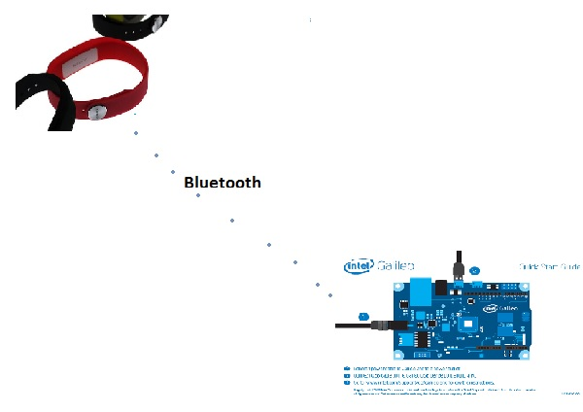

Slide 15
Bluetooth communication between sensors and microcontroller
First we are going to use the Intel Galileo board which is a Dev board to grab the raw data from the wearable sensors. The sensors are broadcasting their data through Bluetooth I assume on a fixed channel using RFCOMM and we can simply use the integrated blue-tooth capability of the microcontroller to connect to the sensors and grab the data we need.

Slide 16
First get basic functionality and build on top of that.
Bluetooth communication between sensors and microcontroller.
Forward data to cell-phone through wireless.

Slide 17
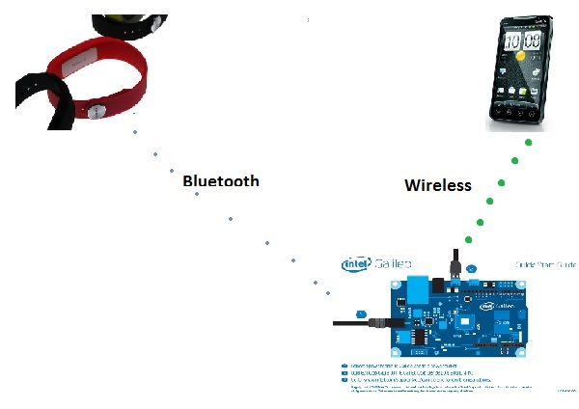

Slide 18
Forwarding data to cell-phone
Once we have developed the code for capturing the data from the sensors we can test establishing a wireless connection to a cell phone and forward the data to it for further processing. Forwarding the data through wireless might require we have a buffer for the data to be transmitted.

Slide 19
First get basic functionality and build on top of that.
Bluetooth communication between sensors and microcontroller.
Forward data to cell-phone through wireless
Try to connect directly to servers in the cloud.

Slide 20
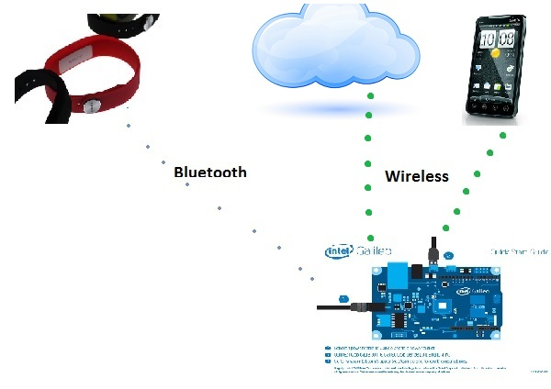

Slide 21
Connecting to servers in the cloud
After we have set up the wireless communication to the patient’s cell phone
the process should be similar for forwarding the information to the servers in the cloud, so we could probably reuse some code here which would cut down development time.

Slide 22
Next steps
Now that we have set up all the connections needed we can start analyzing the data to detect a fall.
After we have the code for detecting a fall we can modify our code to send the data directly to the cloud in case a fall is detected.
We need to test for false positives in the fall detecting code and make sure it only detects actual falls.

Slide 23
Evaluation
We need to evaluate our project at three
different levels to make sure it is functional and reliable.
Our part of the project needs to be very efficient because we are monitoring a patient’s health and any error or malfunction could cause the patient’s life to be at risk.

Slide 24
Evaluation levels
Data transmission
Fall detection
efficiency

Slide 25
Data Transmission
We need to make sure we are able to establish a reliable connection to both the patient’s sensors and the cloud, because we are need to be able to detect any sudden change in the patient’s condition and it is critical that the data we get is accurate.

Slide 26
Fall Detection
We will test the sensor data we get by simulating all the possible scenarios the patient could be in. That way we will have an idea of what data we should expect for each scenario and most importantly detect when the patient is in a critical condition and needs immediate attention.

Slide 27
Efficiency
We will test for efficiency of the code that determines if a patient is in a critical condition. We need this code to be very efficient because it is the most critical part of the system and it needs to be able to react to quick and drastic changes in the data to detect if a person is falling on the ground.

Slide 28
Rough Timeline
It would take us about 2 months to finish the project.

Slide 29
First two weeks
We might need two weeks to familiarize ourselves with the board and all of its capabilities. After we have a good Idea of
how to use the board we can actually start working on it.

Slide 30
Two-three weeks after/end of first month
After that we might need about two weeks to be able to figure out how to get the data from the sensors, since we have to learn about the Bluetooth standard and how to use it to connect to other Bluetooth devices and learn about the wireless standard to send data from the board to a cell phone.

Slide 31
Second month
After we have learned those things the rest will be easy since all we need to do is a little processing of the data and then forward it to a cell phone or to a server. After we have managed to set up both the wireless communication and the Bluetooth communication we should be able to finish the rest in one or two weeks

Slide 32
Total Time
In conclusion in might take us about two months to finish this project.

